Slide 1
Lecture 6 Image Restoration/Inverse filters
ECE 1390/2390
Learning Objectives:
Types of noise/artifacts
Inverse filter
Wiener filter

Slide 2
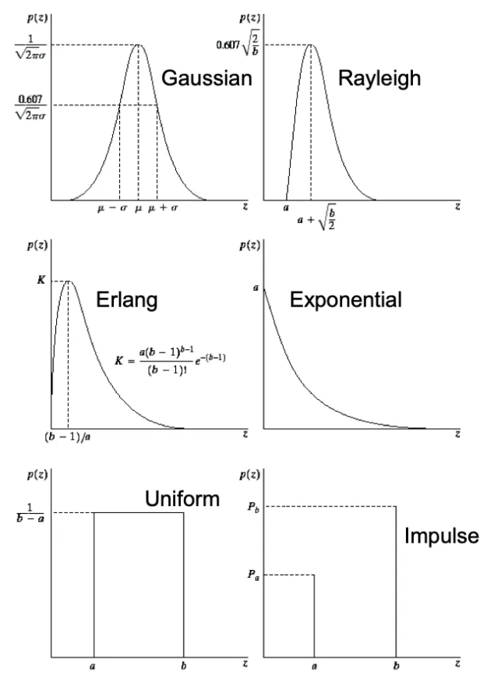
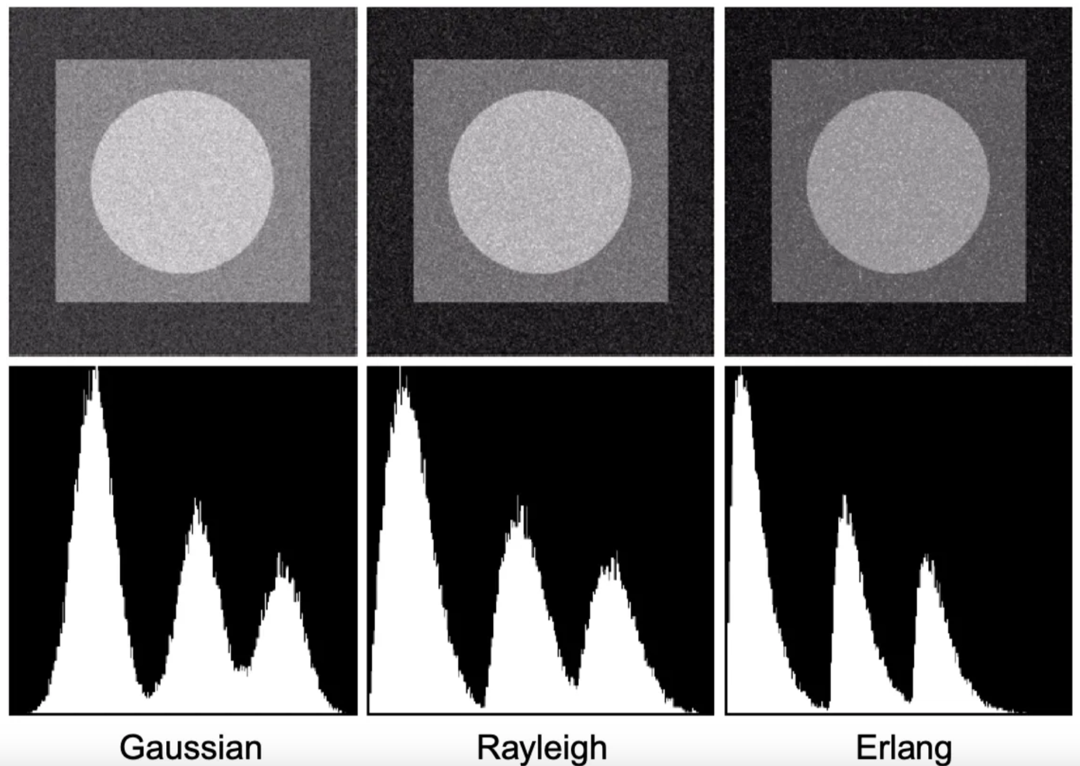
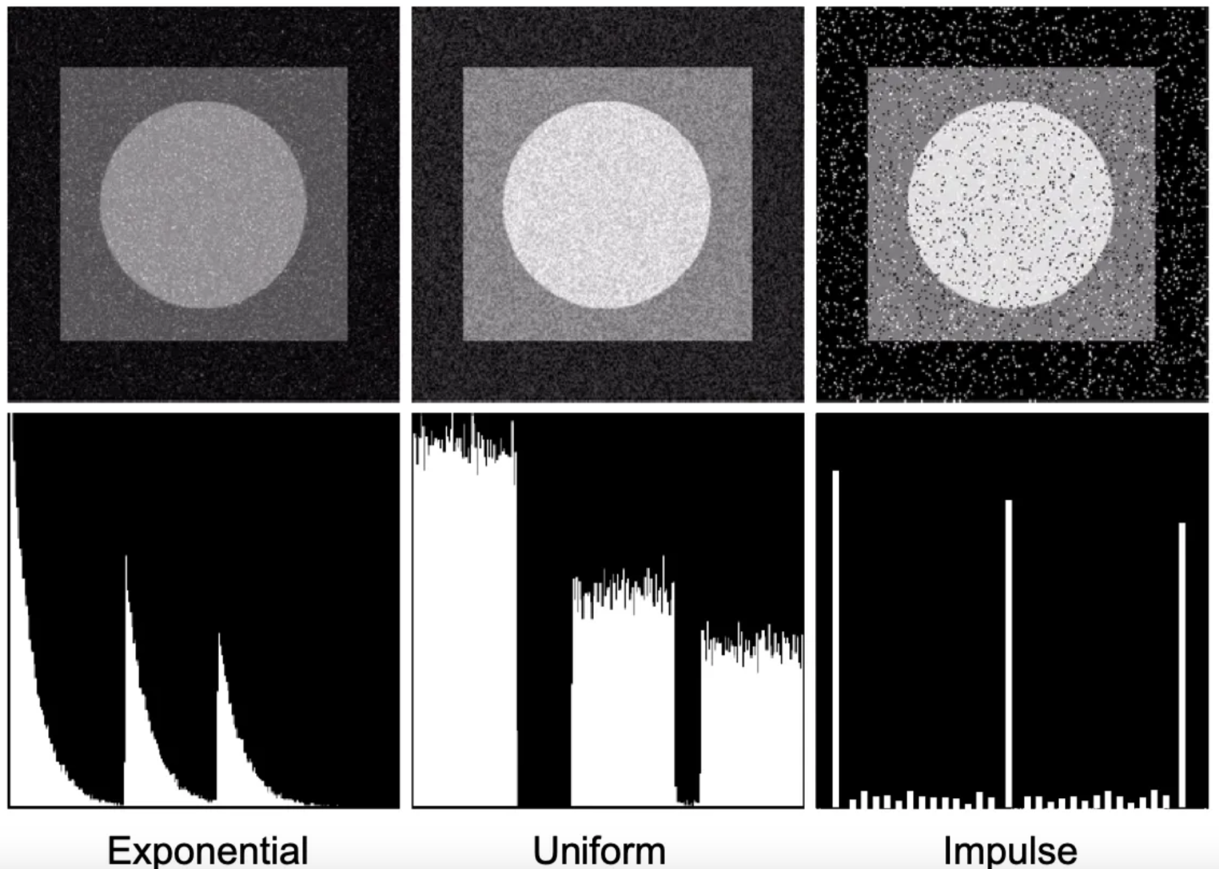
Salt & Pepper

Slide 3
Digital Noise
Image sensor is broken
Affected by external factors;
Low levels of light
High levels of light (saturation)
Heating of sensor
Interference from sensor to DAC.
Gaussian Noise
Additive (positive & negative)
Transmission noise
Thermal effects
Electronic noise
To fix:
Mean filter
Smoothing
Rayleigh Noise
Additive (positive only)
Transmission noise
Thermal effects
Electronic noise
To fix:
Mean filter (positive bias)
Smoothing (positive bias)
Salt & Pepper Noise
Defective pixels
To fix:
Median filter
Center ignore filter
Contra-harmonic filter

Slide 4
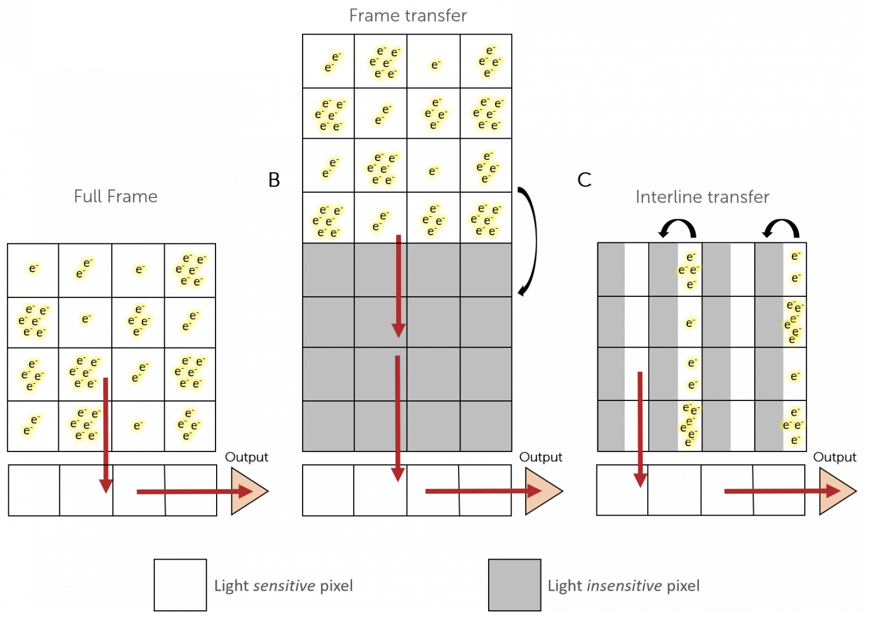
CCD Cameras
Everything passed through this pixel
Full transfer
ADC
ADC
ADC
ADC
This data point spent longest “unprotected”
ADC
https://www.princetoninstruments.com/learn/camera-fundamentals/ccd-the-basics

Slide 5
CCD Cameras
This column all passed through this pixel
Semi-Full transfer
Protected
Protected
Protected
Protected
ADC
ADC
ADC
ADC
This data point spent longest “unprotected”
Protected
Protected
ADC
Protected
ADC
ADC
Every data point went through here
https://www.princetoninstruments.com/learn/camera-fundamentals/ccd-the-basics

Slide 6
CCD Cameras
This column all passed through this pixel
Frame transfer
Protected
Protected
Protected
Protected from further light exposure
Protected
Protected
Protected
Protected
This column all passed through this pixel
Protected
ADC
Protected
ADC
Protected
ADC
Protected
ADC
Protected
Protected
Protected
This data point spent longest “unprotected”
https://www.princetoninstruments.com/learn/camera-fundamentals/ccd-the-basics
Protected
ADC
Protected
ADC
Protected
ADC

Slide 7
CCD Cameras
This column all passed through this pixel
Inter-line transfer
Protected
Protected
Protected
Protected from further light exposure
Protected from further light exposure in one step
https://www.princetoninstruments.com/learn/camera-fundamentals/ccd-the-basics

Slide 8

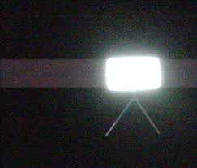
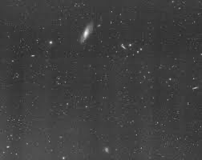
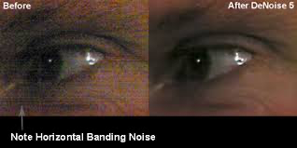
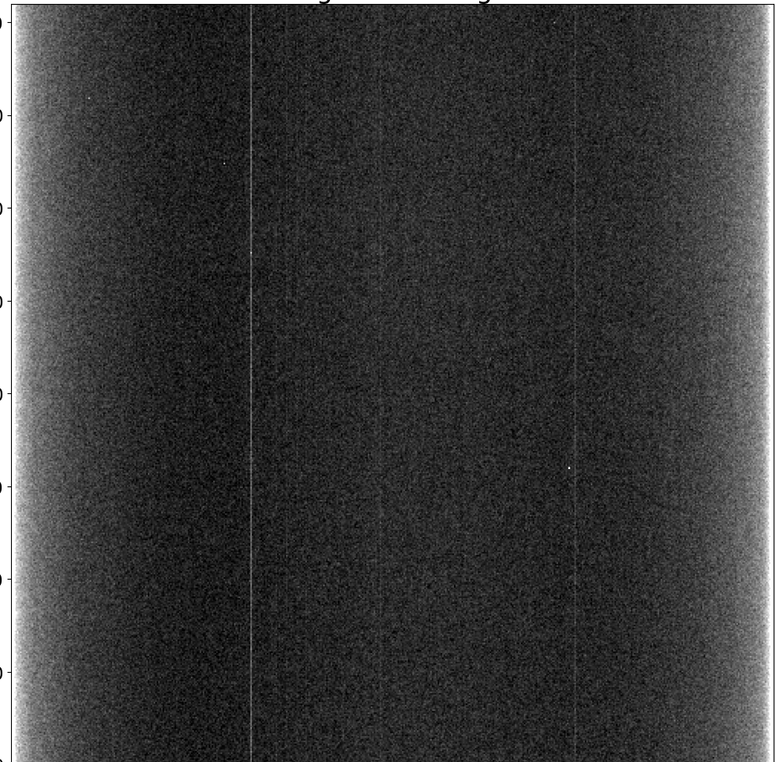
Dark noise pile-up
Dragging data through a bright intensity
More subtle dragging through bright intensity
Horizontal banding
Single column vertical stripes

Slide 9
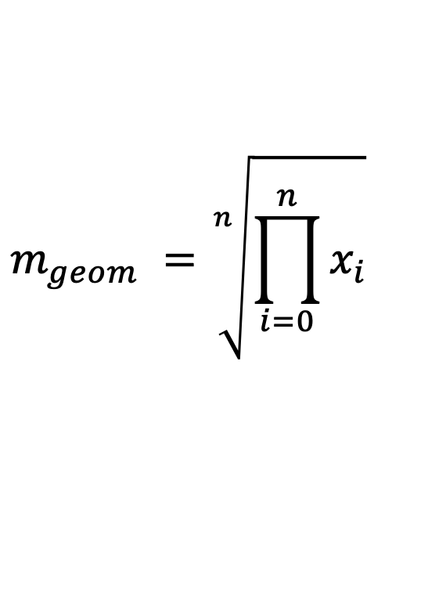
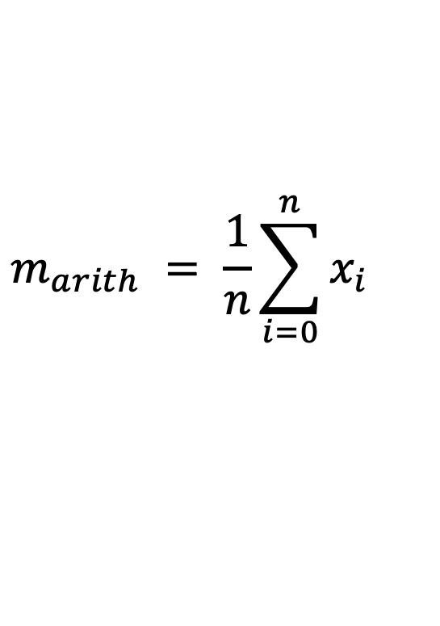
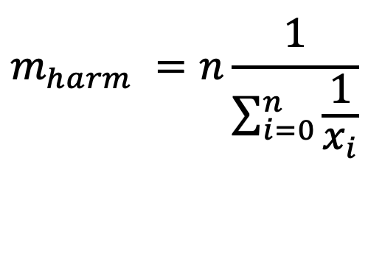
Morphological filters
$$m_{arith} = \frac{1}{n}\sum_{i=0}^{n}{x_{i}}$$
Arithmetic Mean
Smooths image. Removes noise and features of interest
Geometric Mean
Removes noise but preserves features better than arithmetic mean
Harmonic Mean
Good for salt noise (but not pepper)
Works well for other types of noise
$$m_{geom} =\sqrt[n]{\prod_{i=0}^{n}{x_{i}}}$$
$$m_{harm} =n\frac{1}{\sum_{i=0}^{n}{\frac{1}{x_{i}}}}$$

Slide 10
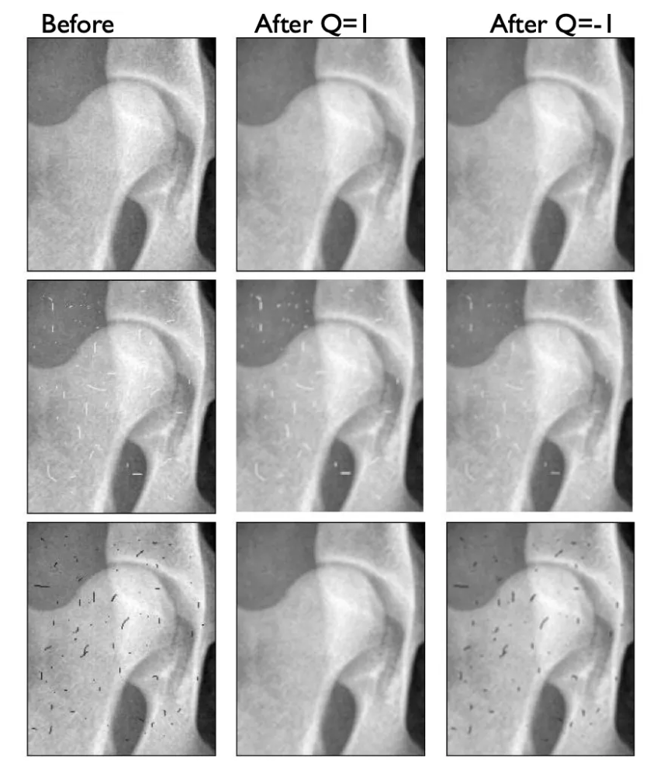
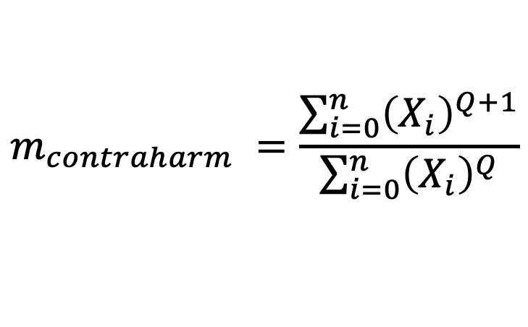
Morphological filters
Contra-harmonic mean
$$m_{contraharm} =\frac{\sum_{i=0}^{n}{{\left(X_{i}\right)}^{Q+1}}}{\sum_{i=0}^{n}{{\left(X_{i}\right)}^{Q}}}$$
If Q > 0, Removes pepper noise
If Q < 0, Removes salt noise

Slide 11
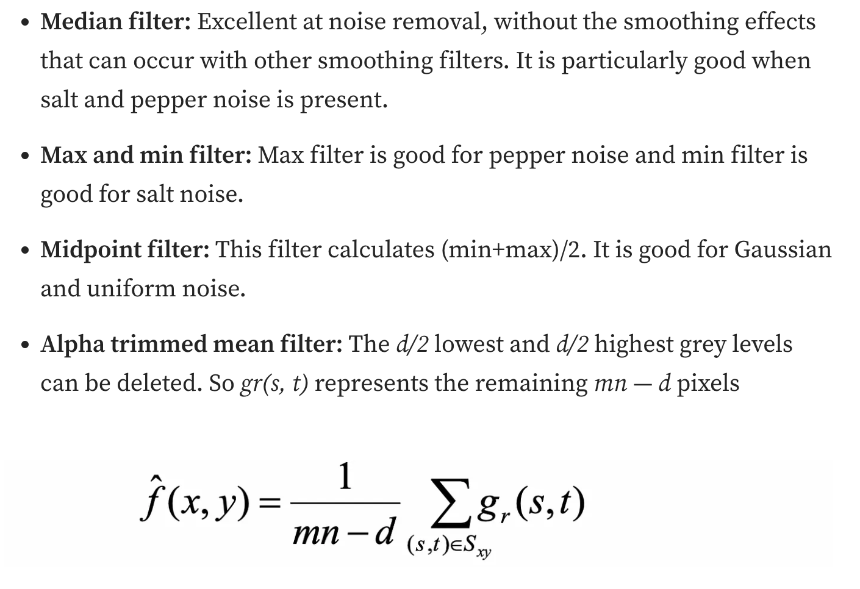
Morphological filters
Notes:
https://medium.com/@gokcenazakyol/how-to-restore-images-image-processing-7-cabf1186fbc5

Slide 12
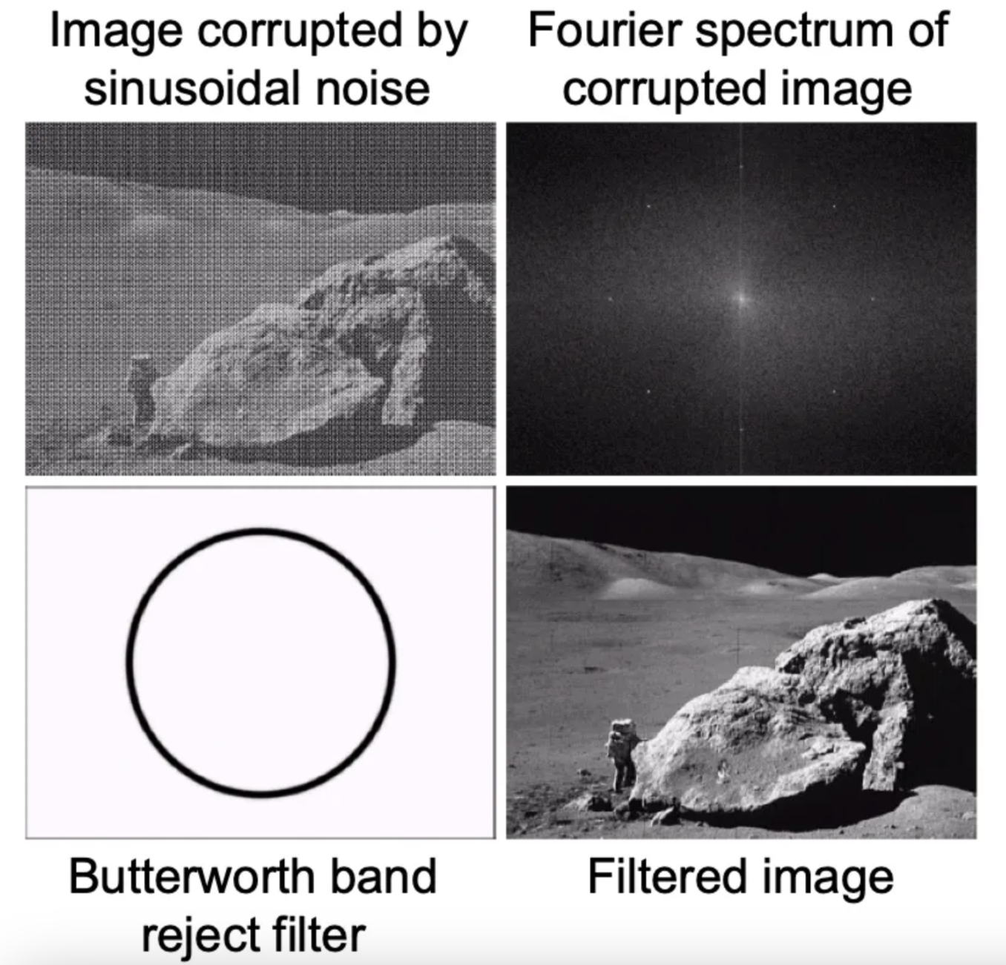

Slide 13
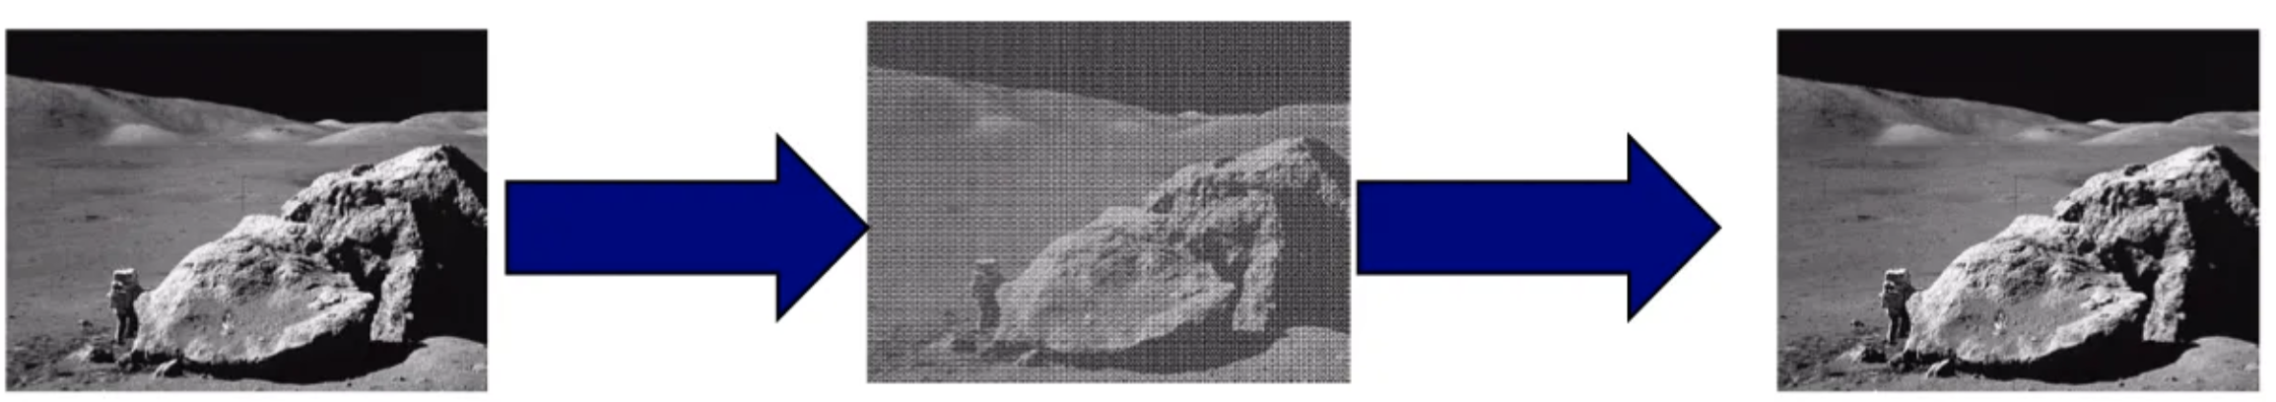
Inverse filters
H(.)
H⁻¹(.)
If I know this part
Then, I can undo it here

Slide 14
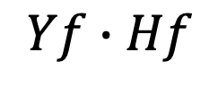
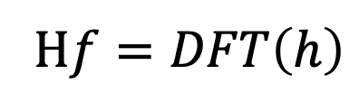
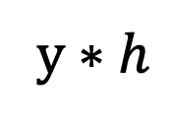
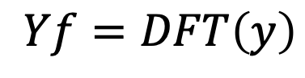
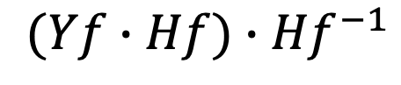
Inverse filters
y $∗h$
$$Yf∙Hf$$
$$(Yf∙Hf)∙{Hf}^{−1}$$
$$Yf=DFT\left(y\right)$$
H$f=DFT\left(h\right)$

Slide 15
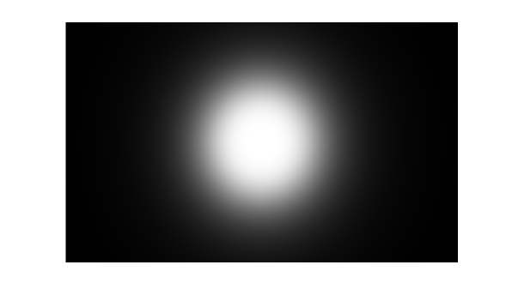
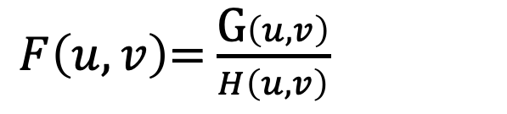
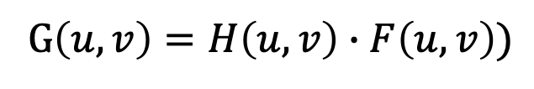
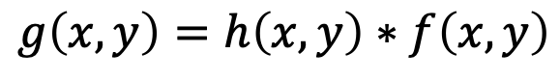
$$g\left(x,y\right)=h\left(x,y\right)∗f\left(x,y\right)$$
G$\left(u,v\right)=H\left(u,v\right)∙F\left(u,v\right))$
$F\left(u,v\right)$= $\frac{\text{G}\left(u,v\right)}{H\left(u,v\right)}$

Slide 16
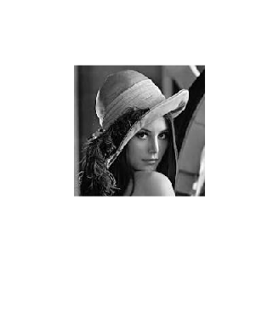
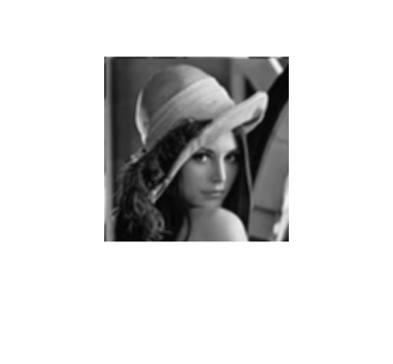
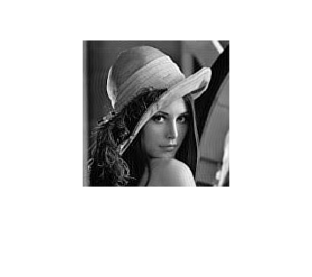
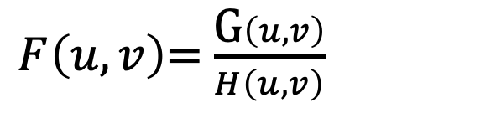
$F\left(u,v\right)$= $\frac{\text{G}\left(u,v\right)}{H\left(u,v\right)}$

Slide 17
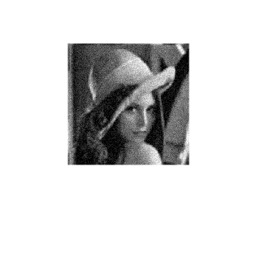
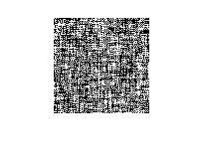
$F\left(u,v\right)$= $\frac{\text{G}\left(u,v\right)}{H\left(u,v\right)}$
+ Noise

Slide 18
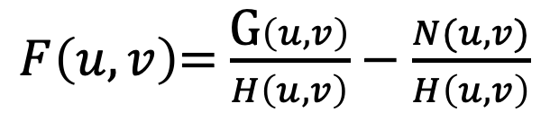
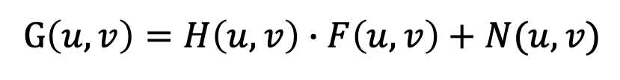
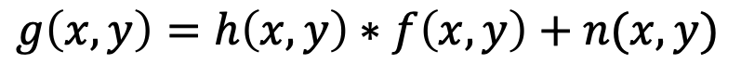
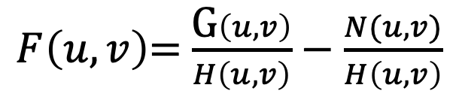
Wiener filter Minimum Mean Least-Squares Error Filter
$$g\left(x,y\right)=h\left(x,y\right)∗f\left(x,y\right)+n(x,y)$$
G$\left(u,v\right)=H\left(u,v\right)∙F\left(u,v\right)+N(u,v)$
+ Noise
$F\left(u,v\right)$= $\frac{\text{G}\left(u,v\right)}{H\left(u,v\right)}−\frac{N(u,v)}{H\left(u,v\right)}$
$F\left(u,v\right)$= $\frac{\text{G}\left(u,v\right)}{H\left(u,v\right)}−\frac{N(u,v)}{H\left(u,v\right)}$

Slide 19
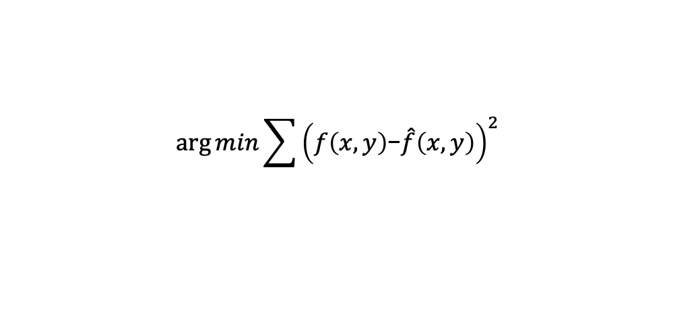
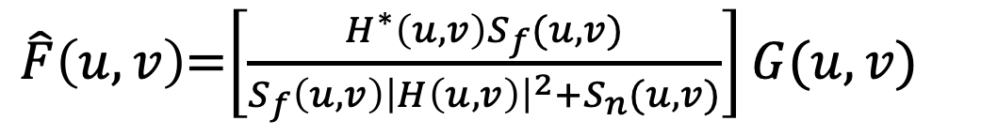
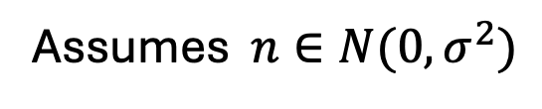
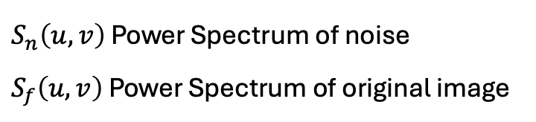
Wiener filter Minimum Mean Least-Squares Error Filter
$$\arg{min}\sum{{\left(f\left(x,y\right)\text{−}\hat{f}\left(x,y\right)\right)}^{2}}$$
Assumes $n∈N(0,σ^{2})$
$\hat{F}\left(u,v\right)$=$\left[\frac{H^{∗}\left(u,v\right)S_{f}(u,v)}{S_{f}\left(u,v\right){\left|H\left(u,v\right)\right|}^{2}+S_{n}(u,v)}\right]G(u,v)$
$S_{n}\left(u,v\right)$ Power Spectrum of noise
$S_{f}\left(u,v\right)$ Power Spectrum of original image

Slide 20


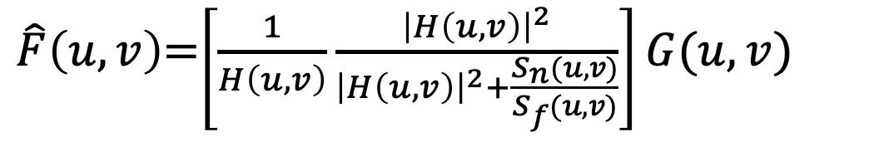
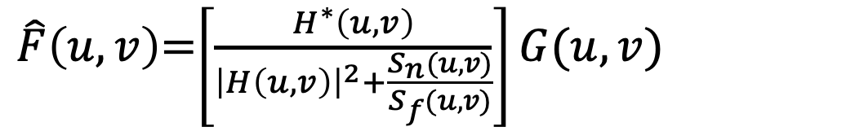
Wiener filter Minimum Mean Least-Squares Error Filter
$$\arg{min}\sum{{\left(f\left(x,y\right)\text{−}\hat{f}\left(x,y\right)\right)}^{2}}$$
Assumes $n is mean zero$
$\hat{F}\left(u,v\right)$=$\left[\frac{H^{∗}\left(u,v\right)S_{f}(u,v)}{S_{f}\left(u,v\right){\left|H\left(u,v\right)\right|}^{2}+S_{n}(u,v)}\right]G(u,v)$
$S_{n}\left(u,v\right)$ Power Spectrum of noise
$S_{f}\left(u,v\right)$ Power Spectrum of original image
$\hat{F}\left(u,v\right)$=$\left[\frac{H^{∗}\left(u,v\right)}{{\left|H\left(u,v\right)\right|}^{2}+\frac{S_{n}(u,v)}{S_{f}(u,v)}}\right]G(u,v)$
$\hat{F}\left(u,v\right)$=$\left[\frac{1}{H\left(u,v\right)}\frac{{\left|H\left(u,v\right)\right|}^{2}}{{\left|H\left(u,v\right)\right|}^{2}+\frac{S_{n}(u,v)}{S_{f}(u,v)}}\right]G(u,v)$
$$\frac{S_{n}(u,v)}{S_{f}(u,v)}=K$$

Slide 21
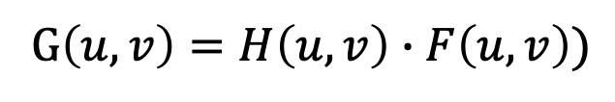
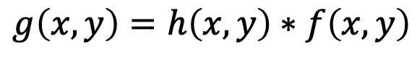

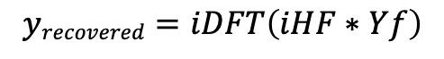
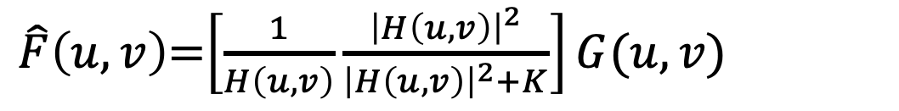
$$K$$
$$g\left(x,y\right)=h\left(x,y\right)∗f\left(x,y\right)$$
$\hat{F}\left(u,v\right)$=$\left[\frac{1}{H\left(u,v\right)}\frac{{\left|H\left(u,v\right)\right|}^{2}}{{\left|H\left(u,v\right)\right|}^{2}+K}\right]G(u,v)$
G$\left(u,v\right)=H\left(u,v\right)∙F\left(u,v\right))$
$$yrecovered=iDFT\left(iHF∗Yf\right)$$

Slide 22
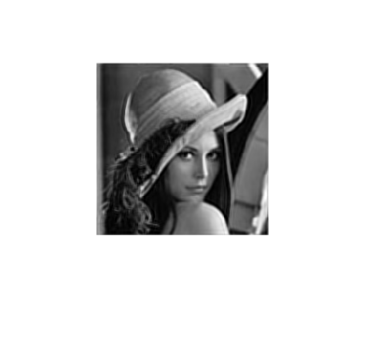
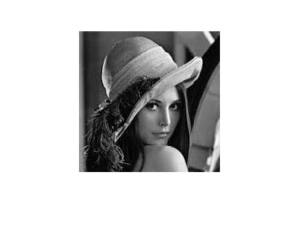
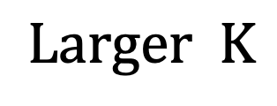

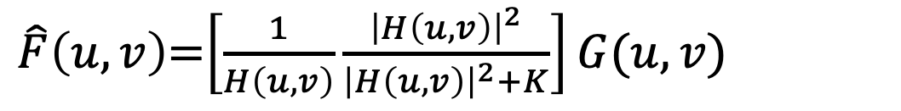
$\hat{F}\left(u,v\right)$=$\left[\frac{1}{H\left(u,v\right)}\frac{{\left|H\left(u,v\right)\right|}^{2}}{{\left|H\left(u,v\right)\right|}^{2}+K}\right]G(u,v)$
$$Larger K$$
$$Smaller K$$

Slide 23
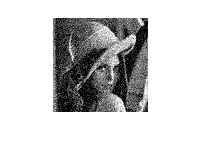




+ Noise
$$Larger K$$
$$Smaller K$$
$$\frac{S_{n}(u,v)}{S_{f}(u,v)}=K=\frac{1}{SNR}$$

Slide 24


Constrained least-squares filtering
$\hat{F}\left(u,v\right)$=$\left[\frac{1}{H\left(u,v\right)}\frac{{\left|H\left(u,v\right)\right|}^{2}}{{\left|H\left(u,v\right)\right|}^{2}+\frac{S_{n}(u,v)}{S_{f}(u,v)}}\right]G(u,v)$
$${\arg{min}\left|f\left(x,y\right)−\hat{f}\left(x,y\right)\right|}^{2}+λ∙\sum_{x=0}^{M−1}{\sum_{y=0}^{N−1}{{\left[∇^{2}\hat{f}\left(x,y\right)\right]}^{2}}}$$

Slide 25




Constrained least-squares filtering
$\hat{F}\left(u,v\right)$=$\left[\frac{1}{H\left(u,v\right)}\frac{{\left|H\left(u,v\right)\right|}^{2}}{{\left|H\left(u,v\right)\right|}^{2}+\frac{S_{n}(u,v)}{S_{f}(u,v)}}\right]G(u,v)$
$${\arg{min}\left|f\left(x,y\right)−\hat{f}\left(x,y\right)\right|}^{2}+λ∙\sum_{x=0}^{M−1}{\sum_{y=0}^{N−1}{{\left[∇^{2}\hat{f}\left(x,y\right)\right]}^{2}}}$$
$${\arg{min}\left|f\left(x,y\right)−\hat{f}\left(x,y\right)\right|}^{2}+λ∙{\left|p\left(x,y\right)\hat{f}\left(x,y\right)\right|}^{2}$$
$p\left(x,y\right)$=$\left[\begin{matrix}0 & −1 & 0 \\ −1 & 4 & −1 \\ 0 & −1 & 0\end{matrix}\right]$
$\hat{F}\left(u,v\right)$=$\left[\frac{1}{H\left(u,v\right)}\frac{{\left|H\left(u,v\right)\right|}^{2}}{{\left|H\left(u,v\right)\right|}^{2}+λ∙{\left|P\left(u,v\right)\right|}^{2}}\right]G(u,v)$
https://www.youtube.com/watch?v=MdWDZx6E13U

Slide 26

Inpainting

Slide 27

Inpainting
Navier-Stokes ( cv.INPAINT_NS)
Fast Marching method ( cv.INPAINT_TELEA)
$$ρ\frac{d\vec{v}}{dt}=−∇p+ρ\vec{g}+μ∇^{2}\vec{v}$$

